Slide 1
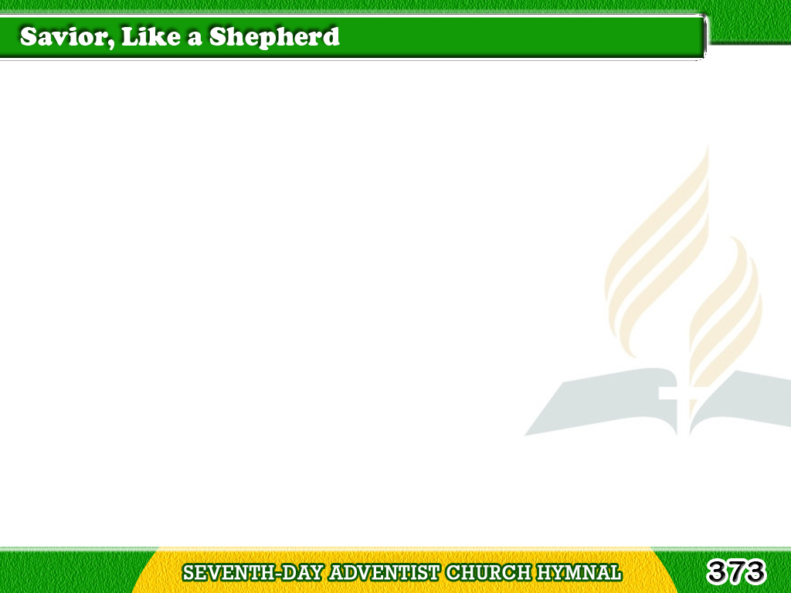
1/3
Savior, like a Shepherd lead us,
Much we need
Thy tenderest care;
In Thy pleasant pastures feed us,
For our use Thy folds prepare.
Tagalog
Version

Slide 2
1/3
Blessed Jesus,
blessed Jesus,
Thou hast bought us,
Thine we are. (2X)
Tagalog
Version

Slide 3
2/3
We are Thine;
do Thou befriend us,
Be the Guardian of our way;
Tagalog
Version

Slide 4
2/3
Keep Thy flock,
from sin defend us,
Seek us when we go astray.
Tagalog
Version

Slide 5
2/3
Blessed Jesus, blessed Jesus,
Hear, O hear us, when we pray!
Blessed Jesus, blessed Jesus,
Hear, O hear us, when we pray!
Tagalog
Version

Slide 6
3/3
Thou hast promised to receive us,
Poor and sinful though we be;
Thou hast mercy to relieve us,
Grace to cleanse,
and power to free.
Tagalog
Version

Slide 7
3/3
Blessed Jesus, blessed Jesus,
We will early turn to Thee;
Blessed Jesus, blessed Jesus,
We will early turn to Thee.
Tagalog
Version

